Slide 1
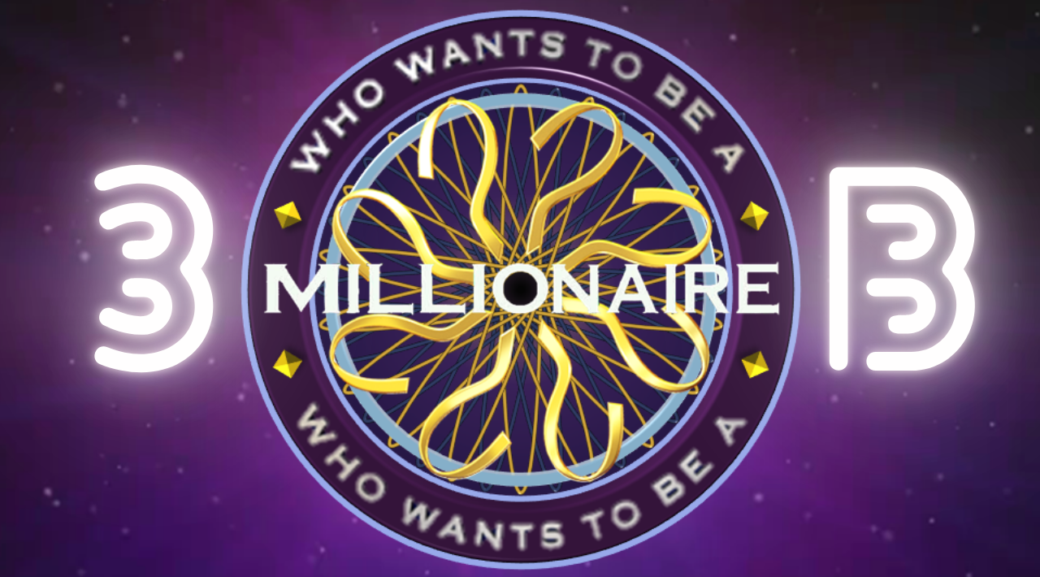


Slide 2
Question 1
£1
What is the capital of France?
A
London
Berlin
C
B
Paris
Rome
D

Slide 3
Question 1
£1
What is the capital of France?
A
London
Berlin
C
B
Paris
Rome
D

Slide 4
Question 1
£1
What is the capital of France?
A
London
Berlin
C
B
Paris
Rome
D

Slide 5
Question 2
£10
Which planet is known as the Red Planet?
A
Earth
Jupiter
C
B
Mars
Venus
D

Slide 6
Question 2
£10
Which planet is known as the Red Planet?
A
Earth
Jupiter
C
B
Mars
Venus
D

Slide 7
Question 2
£10
Which planet is known as the Red Planet?
A
Earth
Jupiter
C
B
Mars
Venus
D

Slide 8
Question 3
£100
How many continents are there?
A
5
7
C
B
6
8
D

Slide 9
Question 3
£100
How many continents are there?
A
5
7
C
B
6
8
D

Slide 10
Question 3
£100
How many continents are there?
A
5
7
C
B
6
8
D

Slide 11
Question 4
£1000
What is the currency of Japan?
A
Yen
Yuan
C
B
Won
Baht
D

Slide 12
Question 4
£1000
What is the currency of Japan?
A
Yen
Yuan
C
B
Won
Baht
D

Slide 13
Question 4
£1000
What is the currency of Japan?
A
Yen
Yuan
C
B
Won
Baht
D

Slide 14
Question 5
£10000
What is the smallest prime number?
A
1
3
C
B
2
5
D

Slide 15
Question 5
£10000
What is the smallest prime number?
A
1
3
C
B
2
5
D

Slide 16
Question 5
£10000
What is the smallest prime number?
A
1
3
C
B
2
5
D

Slide 17
Question 6
£100000
Which artist painted the ceiling
of the Sistine Chapel?
A
Leonardo da Vinci
Raphael
C
B
Michelangelo
Donatello
D

Slide 18
Question 6
£100000
Which artist painted the ceiling
of the Sistine Chapel?
A
Leonardo da Vinci
Raphael
C
B
Michelangelo
Donatello
D

Slide 19
Question 6
£100000
Which artist painted the ceiling
of the Sistine Chapel?
A
Leonardo da Vinci
Raphael
C
B
Michelangelo
Donatello
D

Slide 20
Question 7
£1000000
What is the approximate value
Of Pi to three decimal places?
A
3.124
3.169
C
B
3.141
3.133
D

Slide 21
Question 7
£1000000
What is the approximate value
Of Pi to three decimal places?
A
3.124
3.169
C
B
3.141
3.133
D

Slide 22
You’ve
Just
Won
£1000000

